Slide 1
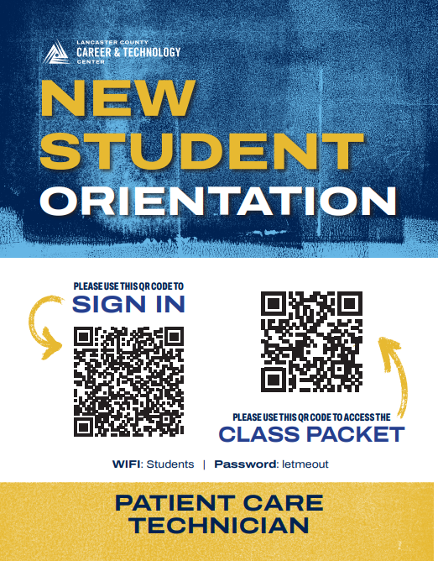
Please scan the New Student Orientation QR code regarding important paperwork for the class. Please feel free to walk around the room or have a seat.

Slide 2
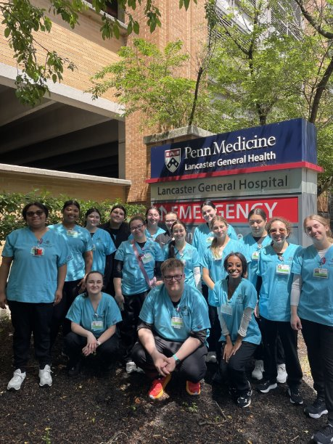
WELCOME CLASS OF 2027 Patient Care Technician
2

Slide 3
Typical Day in the Classroom
½ Day Theory
Anatomy & Physiology
Medical Terminology/Abbreviations
Earn credits from HACC if participating in dual-enrollment
Nursing Assistant
½ Day Skills
Taking BP/Pulse/Respiration/Temperature
Making beds, transferring patients to chairs, wheelchairs, and bedside commodes, post-mortem care, removing IV's & foley catheters
Personal care of a patient- bathing, feeding, and dressing
EKG's & bladder scans

Slide 4



Textbooks
A&P and Nursing Assistant textbook must be returned at the end of the year
Workbooks are yours to keep

Slide 5
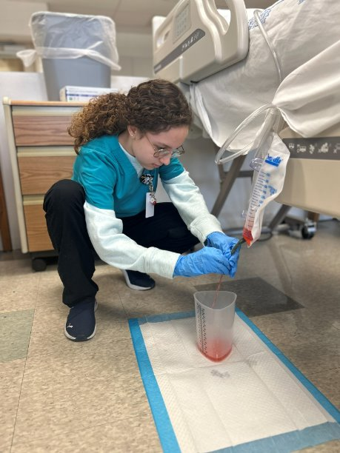
Task Grid Overview
Safety
Communication
Infection Control
Health Care Provider Skills
Medical Terminology
Growth & Development
Anatomy & Physiology
Maternity
Death & Dying
Emergency Care

Slide 6
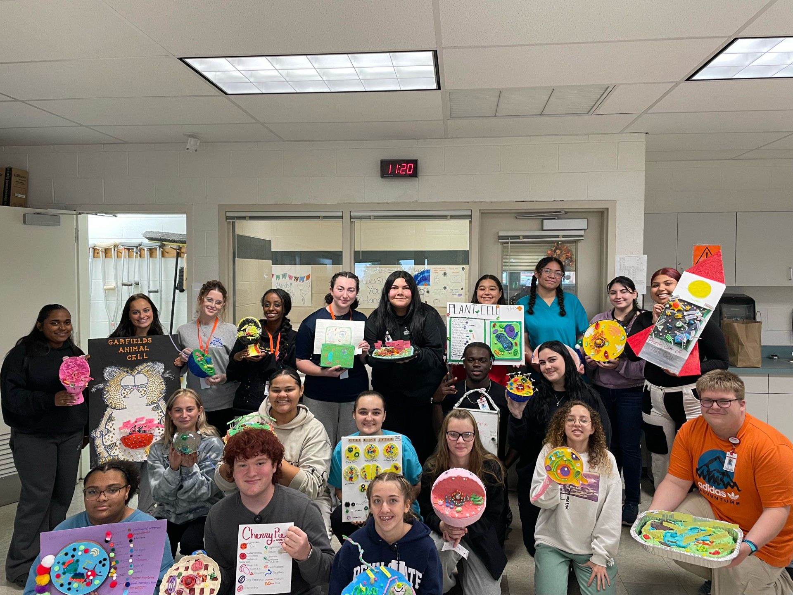
Grading
Theory 33%- written tests in A&P, medical terminology, medical abbreviation, and nursing assistant
Missed tests due to absence must be completed in 2 days or the student will receive a zero
Skill 33%- hands-on testing, some written NA tests
Daily Score/Employability 34%
Uniform
Attendance & calling when absent
Assignments turned in on time
Good use of skill lab practice time
Maturity

Slide 7
Clincal Requirements
Grades/Attendance
Must notify instructor by 7:30 that you will be absent, if not automatic loss of 2 work ethic points next day present
Healthcare Provider CPR- will be taught in class
Physical Exam & clearance from physician that you can perform duties of nursing assistant
Background Checks
PSP Patch
Child Abuse
FBI Fingerprinting
Current Vaccinations
Chicken Pox (Varicella), MMR, TDAP, Hepatitis B
2 Step PPD Testing or QuantiFERON Blood Test
**DO NOT GET QuantiFERON BEFORE 2/27**
COVID-19* and Flu shot
COVID-19 is not currently required, but subject to change

Slide 8
Clinical Requirements
All clearances and immunizations are due by 12/4
It is a privilege
Grade Requirements
90% average in daily score
85% average in theory
85% average in skill testing
Competent or Advanced on NOCTI at the end of the year
Less than 5 days absent
Included in this total are tardies to school. Once you reach 5 tardies, you will earn 1 absence.

Slide 9
Clinical Requirements
Must provide own transportation
6:30-2:00
LGH & WellSpan Ephrata are clinical sites
Mandatory drug screening prior to start of clinical
Instructor discretion as to hospital placement
Students may rotate through both facilities

Slide 10

Uniforms
Black, ciel blue, hunter green, or royal blue scrub pants
Ciel blue, hunter green, or royal blue (required for clinical with LCCTC logo) scrub top
Shoes- must be athletic sneakers or nursing shoes
Other items available- lab jacket, a sweatshirt with school logo and class name
Watch with second hand
Student ID badge
Must be worn at all times
Pictures will be taken during first week of school

Slide 11
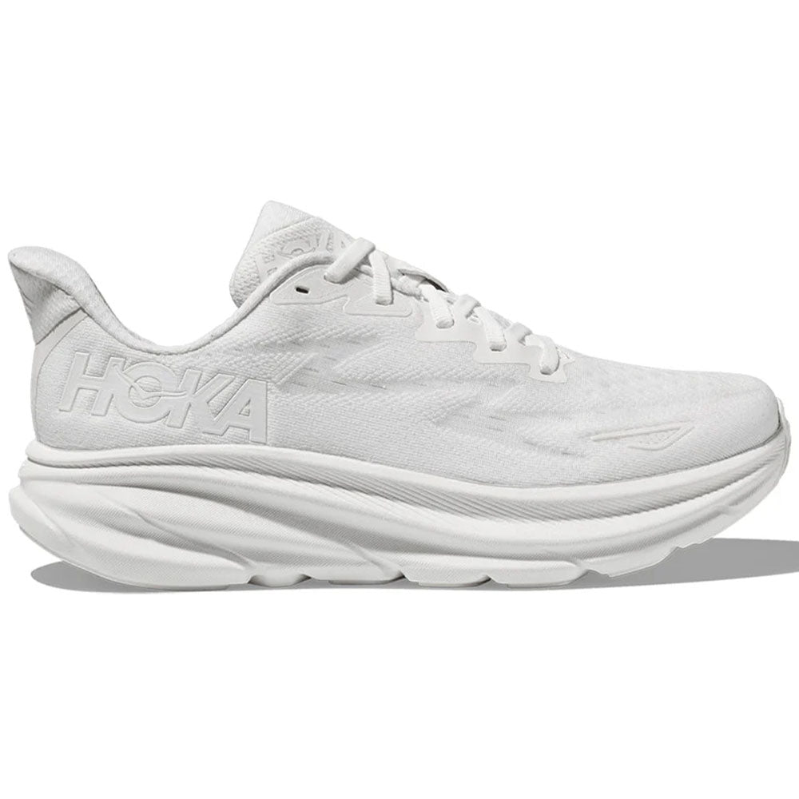


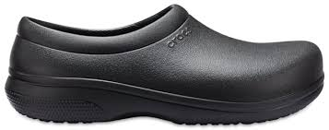

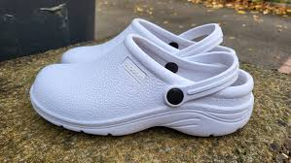


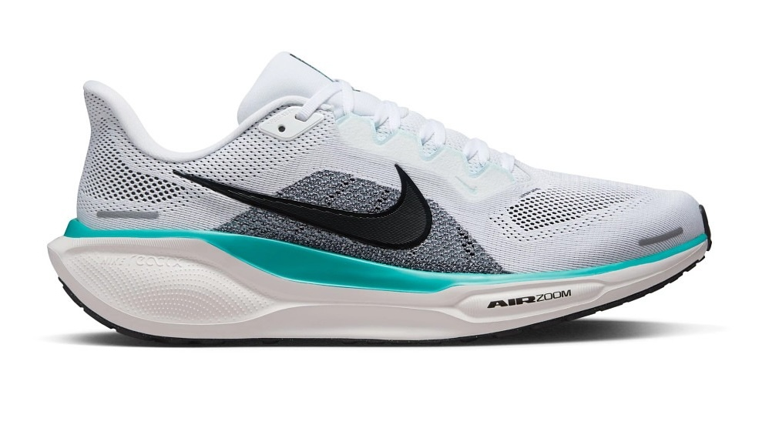
Uniform- What to Wear

Slide 12

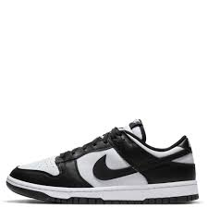
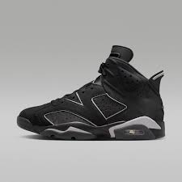
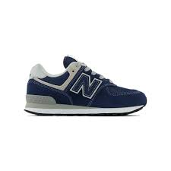


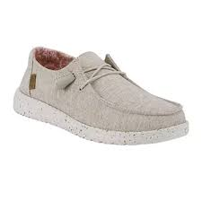

Uniform- What NOT to Wear

Slide 13
How to Order Uniforms
https://fplancasterstores.com/lancasterctc/store/patient-care-technician-willow-street
Fully Promoted
155 Roherstown Road Lancaster Pa 17603
Must order by June 27th for ensure delivery for first day of school August 20th.

Slide 14




CAREER & TECHNICAL STUDENTS ORGANIZATIONS
Skills USA
HOSA
Future Health Professionals
FFA
For Animal Production students
National Technical Honor Society
Must meet requirements- more info at the start of school

Slide 15

NOCTI
State test in end of March
Written test
Computerized
Hands-on skills
Vital signs and height & weight
Handwashing and applying & removing PPE
Transferring patient from bed to wheelchair and return to bed
Changing patient gown
Must score competent or advanced to participate in internship

Slide 16


Certifications Available
OSHA 10 Healthcae
Heartsaver First Aid
BLS CPR
Mandated Reporter
Patient Care Technician
Not required
School will pay for certification

Slide 17
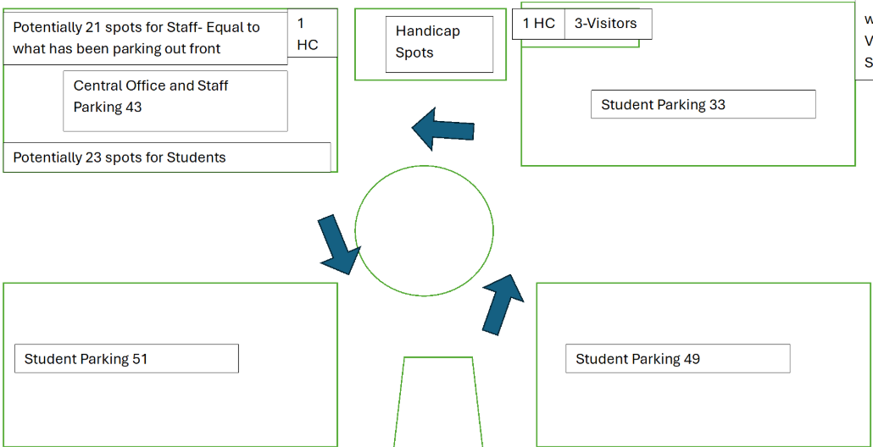
Driving Policy
All drivers must be in class by 8:00 am and are dismissed at 2:35 pm
Parking permit must be displayed

Slide 18
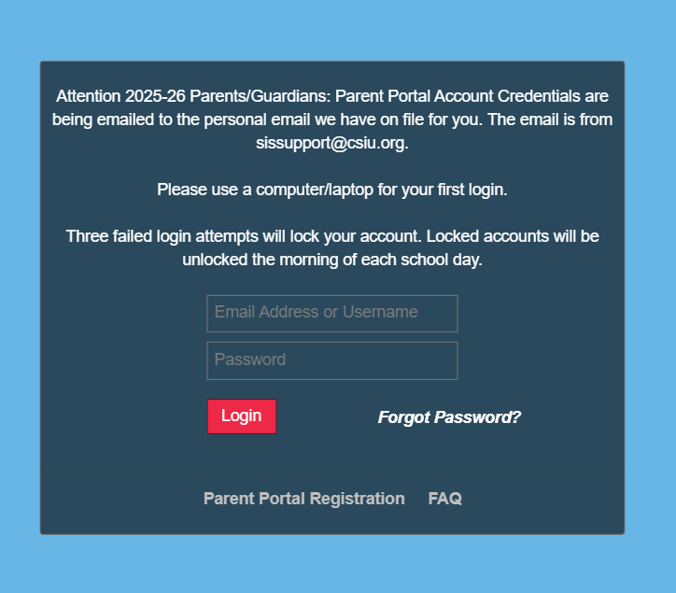
Parent Portal
Site for parents to check grades
Students may also sign up to see grades & attendance

Slide 19

QUESTIONS AFTER THIS EVENING?
Mrs. Ashley Seibert- Instructor
Email: aseibert@lancasterctc.edu
Phone: 717-464-7050 ext: 7092
Mrs. Ami Gallo- Counselor
Email: agallo@lancasterctc.edu
Phone: 717-464- 7050 ext: 7080
Support Staff
ELS: Mrs. Collier & Mrs. Fields
IU 13 Staff: Mrs. Brooks & Mrs. Kralicek

