Slide 1






MEDICAL ASSISTANT
PROGRAM
LANCASTER COUNTY CAREER AND TECHNOLOGY CENTER
WILLOW STREET CAMPUS
MS. HOLLY MAISANO, CMAA (AAMA)
MRS. JESSICA WEINODLT, R.T.(R)(M)(CCMA)(ARRT)

Slide 2



INDUSTRY DESCRIPTION
CLINICAL MEDICAL ASSISTANT
  ADMINISTRATIVE MEDICAL ASSISTANT
  RECORDING VITAL SIGNS
  CHECKING PATIENTS IN AND OUT
  OBTAINING MEDICAL HISTORIES
  SCHEDULING APPOINTMENTS
  PREPARING PATIENTS FOR EXAMINATIONS
  PHLEBOTOMY
  EKGS
  ADMINISTERING MEDICATIONS
  INJECTIONS
  INSURANCE VERIFICATIONS
  BILLING AND CODING
  TELEPHONE CALLS

Slide 3
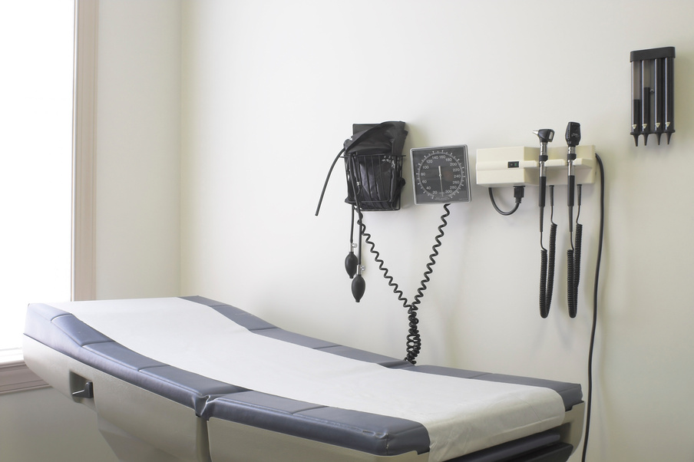
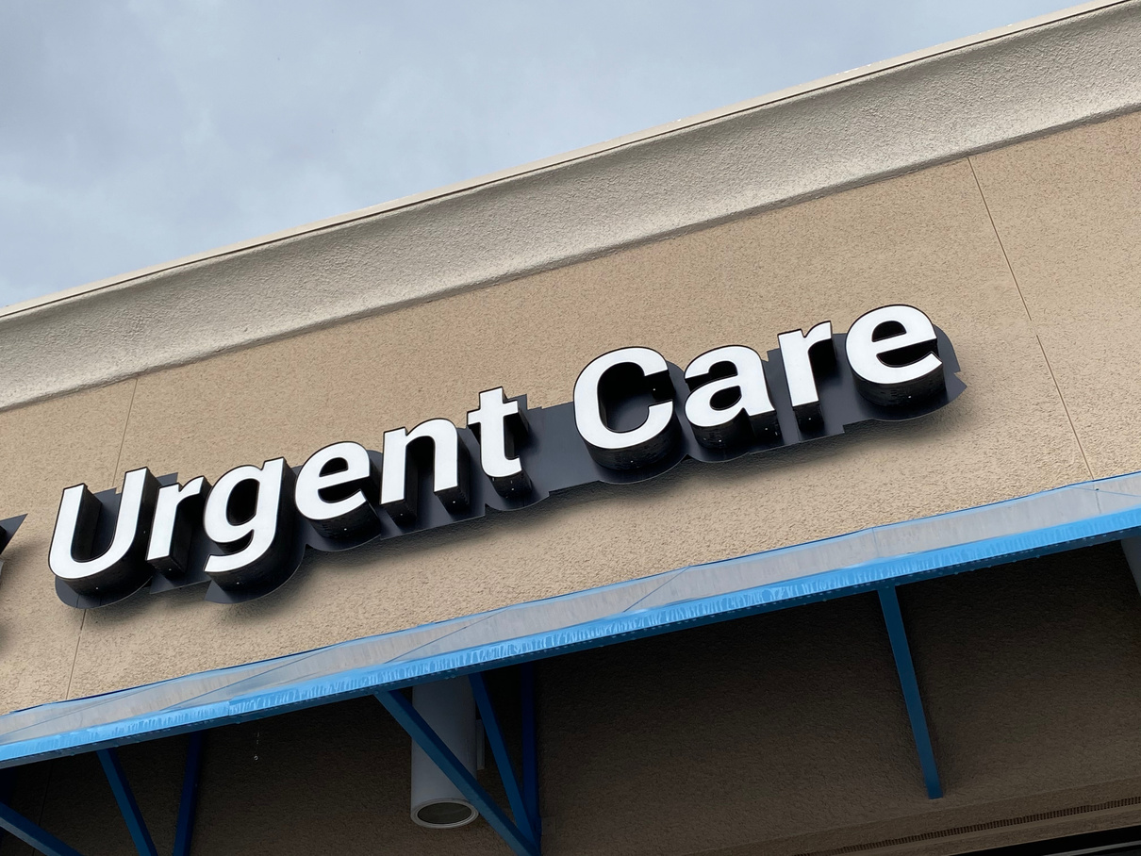
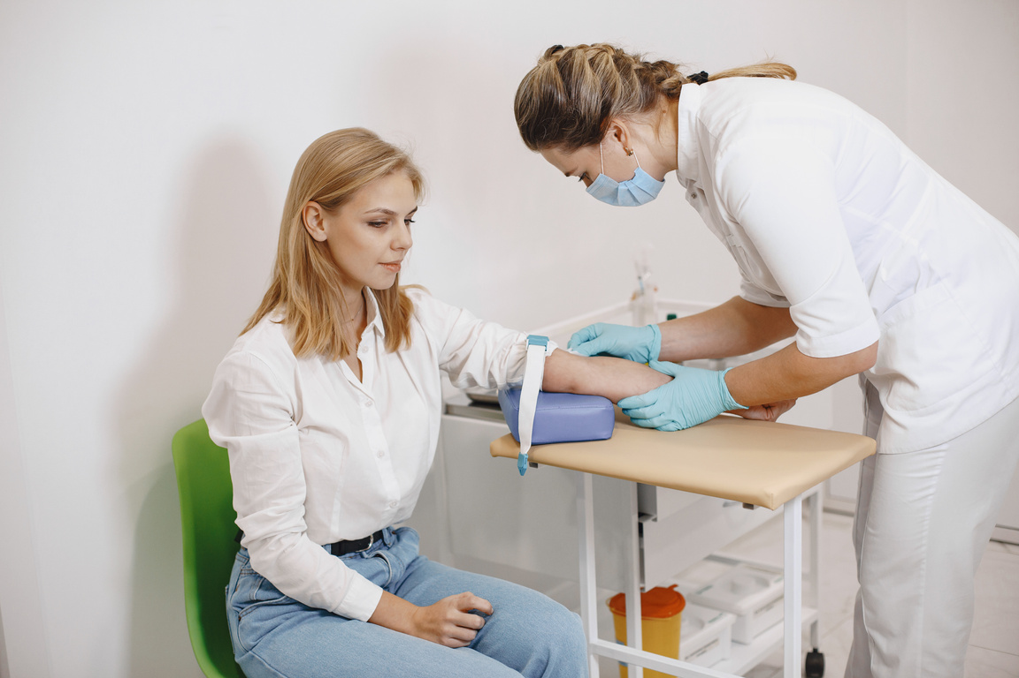


WHERE DO MA’S WORK?
DOCTOR’S OFFICES
URGENT CARES
LABORATORY SETTINGS
SPECIALTY OFFICES

Slide 4


MA ACADEMIC SUBJECTS
HEALTHCARE BASICS
Medical
Terminology
Clinical
Medical Assistant
Anatomy &
Physiology
Pharmacology
THE IMPORTANCE OF CARE
COMMON HEALTHCARE
Medical
Abbreviations
Electronic
Medical
Records
Administrative
Medical Assistant

Slide 5



MA GRADING POLICY
  Students/Parents or Guardians will have access to CTC’s grading portal once the school year begins
  Grades are updated on a weekly basis

Slide 6


KNOWLEDGE: 50% OF GRADE
  Tests
  Homework assignments
  Projects
What to expect:
  Homework/Study Time: 1-3 hours every night
  Tests: Daily

Slide 7


SKILLS: 25% OF GRADE
  Skills are graded on a scale of “0-10”
Example score: 10-perfect performance
0-skill not completed
  A rubric for each skill will be given so students are aware of what will be tested on
  We will have about 180 skills to complete this school year!

Slide 8

DAILY SCORE: 25% OF GRADE
Work ethic is evaluated to encourage behavior that would help students obtain and keep employment
What we are looking at:
  Attitude
  Cooperation
  Punctuality
  Initiative
  Completing assignments
  Following Dress Code
  Following Cell Phone Policy

Slide 9


MA PROGRAM ENTRANCE REQUIREMENTS
  Physical Exam
  Proof of Current Immunizations (COVID-19 is required at some organizations)
  Flu Vaccine (Mandatory for Clinical Experience)
  2-step TB Test (4 total visits) or QuantiFERON blood test
  Child Abuse Background Check
  PA Criminal Background Check
  FBI Clearance (Fingerprinting)
*Needs to be completed by the
first day of school!

Slide 10

PROGRAM COSTS
  Uniforms must be purchased from our online store through Fully Promoted. We recommend having 3 pairs of pants, 3 tops, and 2 jackets
  Follow Instructions on uniform handout to purchase uniforms... make sure to complete by deadline to avoid being backordered
  We also strongly suggest getting the Microfleece jacket and sweatshirt. It gets chilly in our classroom in the winter!
  CPR certification will be done in class. This cost is around $15.00 for the card (subject to change)
  Parking Permit, if you choose to drive to CTC

Slide 11

DRESS CODE
  Students are required to be in uniform on the first day of class!
  Scrub colors are: Black, Eggplant (purple), Orchid (light purple), Navy (blue)
  SNEAKERS MUST BE CLEAN. ATHLETIC SHOES ARE PERMITTED. CROCKS ARE OKAY, BUT NO HOLES! ABSOLUTELY NO CONVERSE, JORDANS, UGGS, HEY DUDES, VANS
  Coordinating colored shirt or turtleneck under tunic top is acceptable.
  Outermost layer must be CTC.
  CTC sweatshirts & jackets ARE permitted.
  CTC ID Badge

Slide 12


DRESS CODE
  Tattoos are permitted as long as they are not offensive and are tasteful
  Nails: Clean, ⅛ inch, NO POLISH, ARTIFICIAL, OR GEL NAILS!
  Hair: Must be pulled back and out of the face while in the clinic area. Must be natural colors and professional looking
  No smartwatches!
  Piercings: Only 2 per ear, small, professional. No hoops. Nasal stud acceptable but no hoops. No septal piercings or other facial piercings. Must use a clear spacer!

Slide 13





QUALIFICATIONS FOR 7-WEEK INTERNSHIP EXPERIENCE!
  Less than 5 absences for the entire school year
  Knowledge score of 75% or higher
  Daily score of 85% or higher
  Skills grade of 85% or higher
  Clear background checks
  No discipline referrals
  Own transportation
  Drug Screen
  Passing score on NOCTI
TECHNOLOGY 2
**Remember, work experience is a privilege and must be earned!

Slide 14

MA CERTIFICATION THROUGH THE NHA
  Requirement: Successful completion of the MA Program AND 210 Hours of Clinical Experience
  National HealthCareer Association (NHA) :
    Certified Clinical Medical Assistant (CCMA)
    Cost is $160.00 (Covered by CTC for high school students who have completed clinical internship)
  www.nhanow.com

Slide 15
DAY IN THE LIFE OF AN MA STUDENT!
  Two Instructors- Day is split between the two instructors
  Drivers are here from 8-2:35 every day
  Extra study/skill practice from 8-9 and 1:30-2:30 until all busses have arrived
  Tests are taken at 9am every morning before splitting up into separate groups
Monday | Tuesday | Wednesday | Thursday | Friday
Medical Language | A&P | MAA | LAB | LAB
Medical Abbreviations | CMA | LAB | PHARM | LAB
Ms. M
Mrs. W

Slide 16

QUESTIONS?
Holly Maisano:
Email:hmaisano@lancasterctc.edu
Phone: 717-464-7050 Ext. 7094
Jess Weinoldt:
Email: jweinoldt@lancasterctc.edu
Phone: 717-464-7050 Ext. 7087

