Slide 1
Please scan the QR code with your phone to sign into our session tonight!
Students
Parents

Slide 2
Full-day, multi-generational program
College-level class
Academically oriented
Research, Reading and Writing Intensive
Hands on with children
Elementary school/special needs placement
Notes:
Handouts: Skills Alignment Chart

Slide 3
Classroom/Theory Work
Lecture
Combination of independent and group lessons
Written and project based assessments
Homework nightly
Internet access at home
Student Chromebook computers will be issued the first week of school
Notes:
Handout: ECE Task Grid

Slide 4
Certifications and Credentials
Pediatric First Aid/CPR (Program Paid)
Mandated Reported Training (Free)
Getting Started with Center Based Care: Building Blocks for Quality (Free)
PA Key – Fire Safety Training (Free)
Assistant Group Supervisor – Pennsylvania Department of Human Services
CDA-Ready – Pennsylvania Department of Education (Based on National Credential)
Other trainings may be available to students based on recommendations from the field

Slide 5
Statewide Program of Study
Earn up to 9 college credits at SOAR colleges across Pennsylvania
PDO Grant – Millersville/HACC
Maintain an 80% average
Complete all tasks with a minimum of 8/10 score
Pass NOCTI test at Competent/Advanced level
Notes:
Handouts: SOAR Pamphlet and College Articulation Agreement Form

Slide 6
Hands on Experience
Tuesday and Thursday FULL DAY Experiences!
Student will have the following placements:
Infant
Toddler
Preschool
Special Needs
Elementary
STUDENTS MUST HAVE TRANSPORTATION TO CLINICAL PLACEMENTS (Either parents or student driver)!

Slide 7
Required Forms for Experiences with Children
Recommendation Letters x2 (job working with children)
Child Care Staff Health Assessment
Measles Immunity Form
Copy of Immunization Record
Clearances
- NSOR
PA State Police
PA Child Abuse
FBI Fingerprint
ALL DUE VIA GOGGLE FORM BY AUGUST 1st
See GREEN handout for summer workshops

Slide 8





Uniform Requirements
LCCTC Green T Shirt and Crew Neck Sweatshirt
Black Scrub Pants
Sneakers w/tie laces
OPTIONAL: CTC Zip Up Jacket/Fleece Jacket

Slide 9
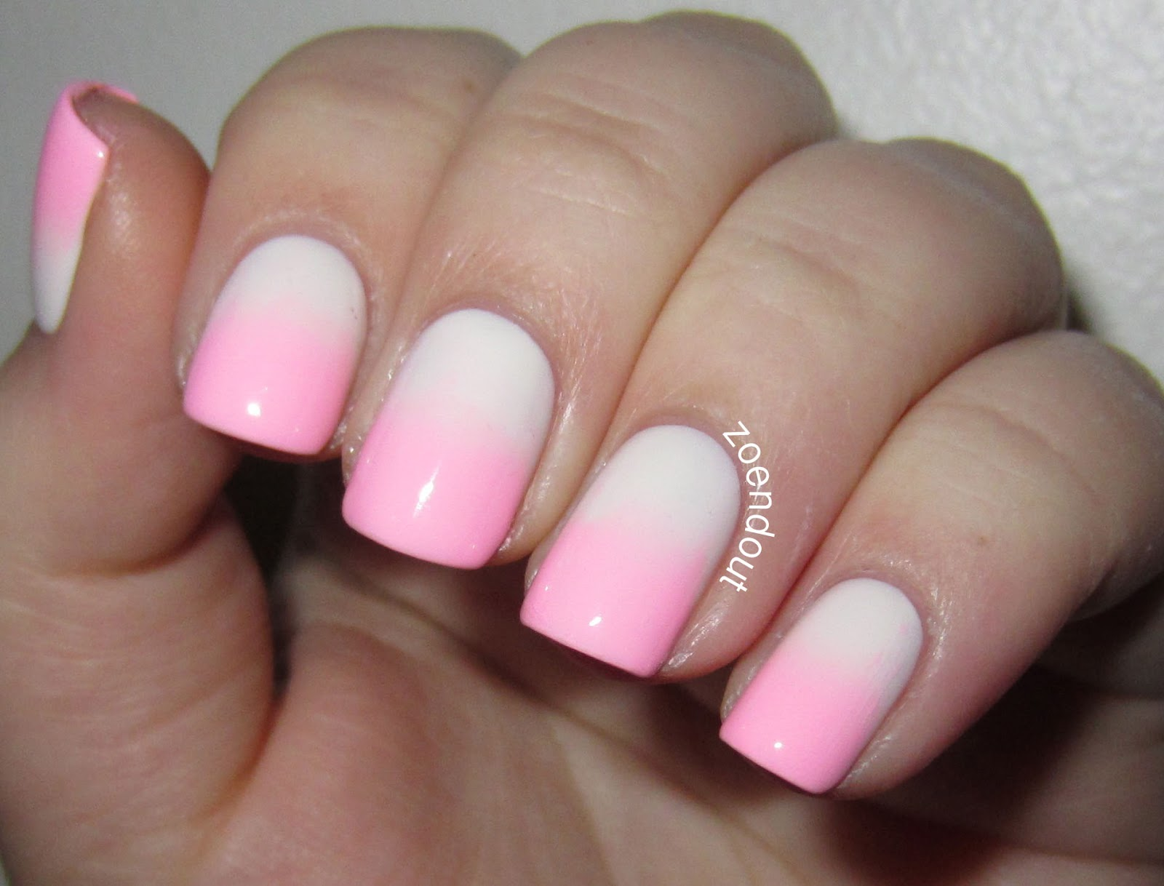

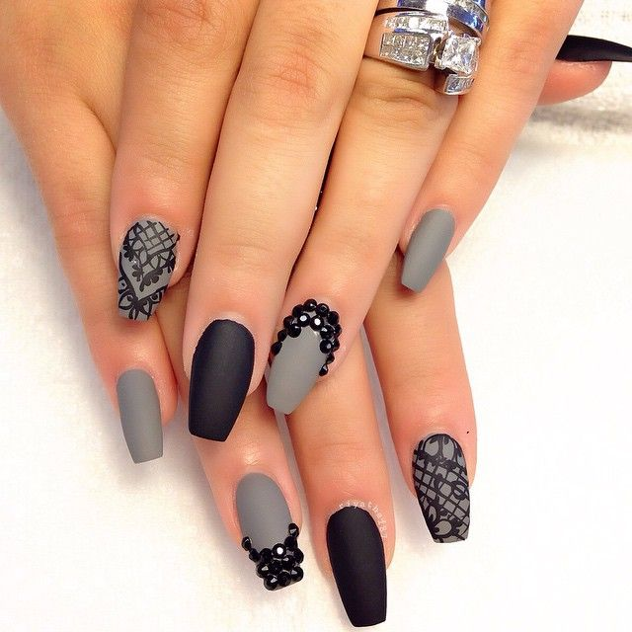
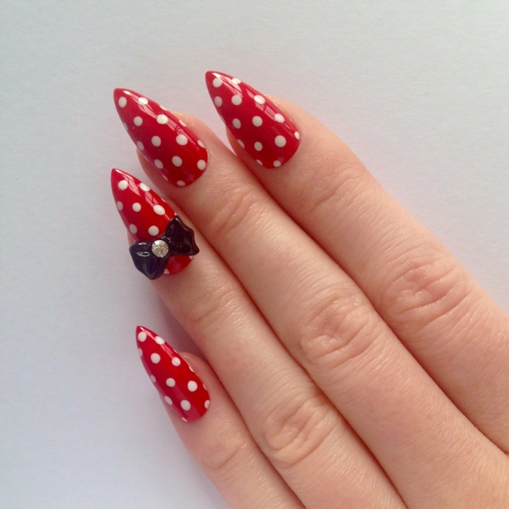




Uniform Requirements
Fingernails – short, clean and well kept
Square Tip and Choking Hazards
This Photo by Unknown Author is licensed under CC BY-ND

Slide 10



Early Childhood Textbooks

Slide 11
Early Childhood Supplies
4 - Three Ring Binders
2 – 4” Binders: White or Black with Title Sleeve
1 – 3” Binder: White with Title Sleeve
1 – 2” Binder with Title Sleeve
Three ring binder pencil pouch (2)
200 clear page protectors
Alphabetical Tab Dividers (A-Z) for 3 ring binder
Yearly planner

Slide 12
Early Childhood Supplies
Office supplies such as:
Markers or colored pencils or crayons
black sharpies
highlighters
glue sticks
adult scissors
pens/pencils
paper clips/binder clips
white out
Post It notes
glue gun w/glue sticks (optional)

Slide 13
Other Included Forms
ECE Monthly Checklist (yellow)
ECE First Day of School Checklist (red)

Slide 14
Other Helpful Notes
Students may find it helpful to drive to school every day/periodically
Students should ask for recommendation letters from school personnel NOW and have them in hand before the end of the school year
Students who have hours with children through high school experiences should get letters from their teachers NOW documenting hours and age groups
Students who have volunteered with children through other organizations should get letters documenting those hours NOW
Students who are looking to get hours through summer experiences should look for INFANT, TODDLER or PRESCHOOL experiences (paid or volunteer)

